Slide 1
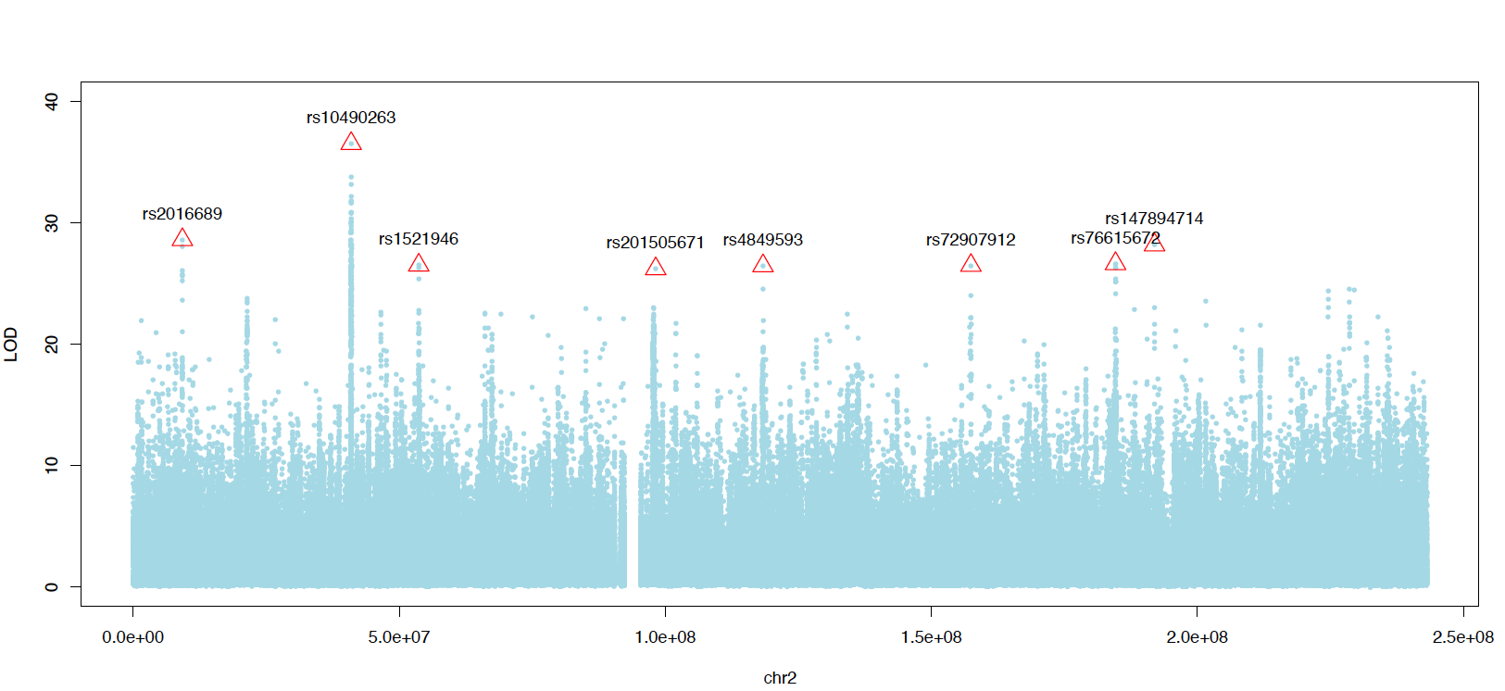
Revised peaks
glmGWAS folder
62 to 79 peaks

Slide 2
Locus in 200K range
LOCI and LOCI21 folder

Slide 3
Extended SNP: 79 to 1090
500K
0.75 PEAK

Slide 4
Effects distribution
glmTable.xlsx

Slide 5
Biotype of proxy genes within 5000 base pair

Slide 6
Consequence of proxy genes within 5000 base pair

Slide 7
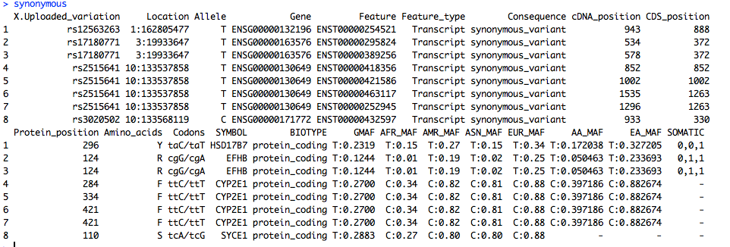
Facts of the synonymous variants

Slide 8
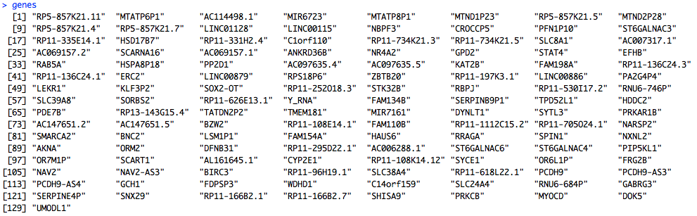
The gene list

Slide 10
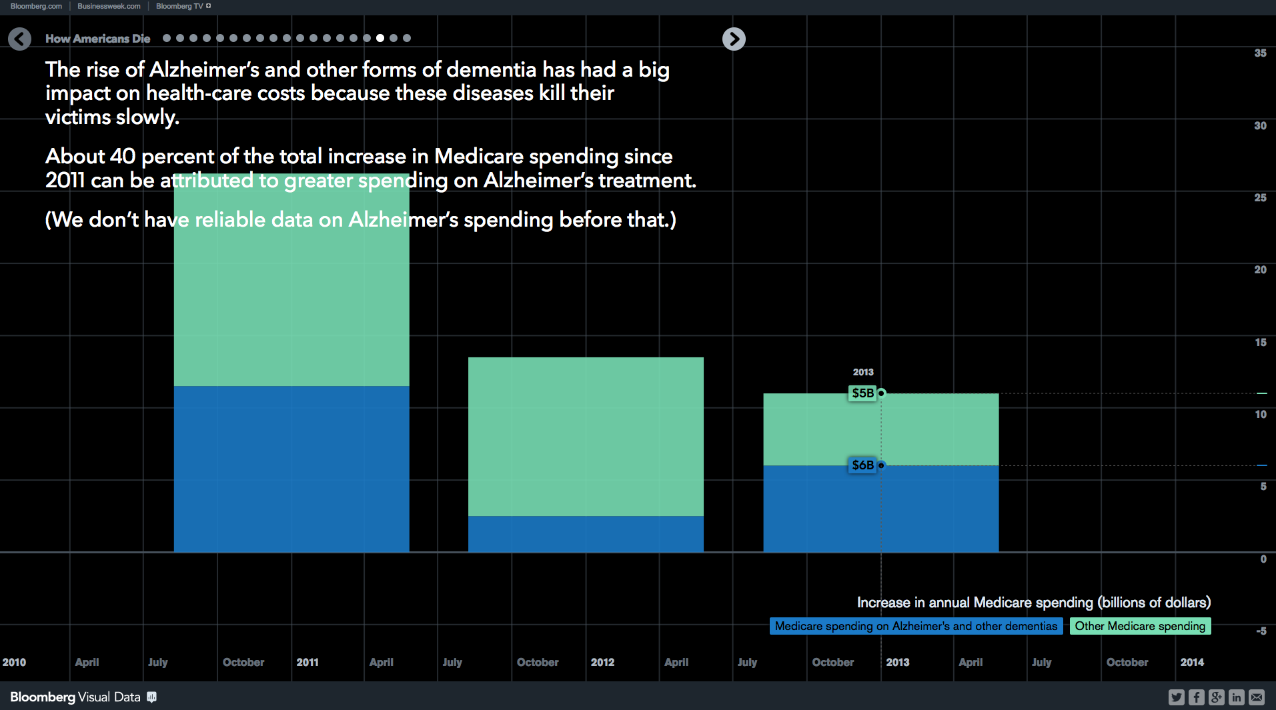

Slide 11
A GWAS study to identify novel genomic variants for Late-onset Alzheimer’s Disease
Xulong Wang

Slide 12
Alzheimer’s Disease Sequencing Project (ADSP)
Objective: Identify genomic variants that increase or decrease the risk of developing AD.
Until today, ADSP project has released the whole genome sequencing data for 584 people across 111 families.
AD diagnosis for 584 people across 111 families.
Age, Sex, and APOE genotype data were collected
Notes:
Initiated by NIH, ADSP is the first large-scale whole-genome sequencing project on AD.
Each person was diagnosed with one of four AD status: no AD, possible, probable, definite. The pie graph shows 10% of them are definite AD, another 63% and 14% are probable and possible AD, and 14% as no AD.

Slide 13
APOE over AD status
APOE ε3ε4 proportion increases with AD probability
APOE ε2 is rare and may protect against AD.
APOE ε3 is the most common allele and plays a neutral role.
APOE ε4 present in about 25 to 30% of population and in about 40 % of people with LOAD.

Slide 14
SNP: summary statistics
rs-prefixed SNP
4.18 –> 5.15 Million SNPs per sample
24 Million by pooling together all samples
8.3 out of 24 Million passed MAF > 0.05
8.24 out of 8.3 Million passed heterozygous frequency (0/1) < 0.95
de-novo SNP
0.24 –> 0.51 Million SNPs per sample
15.4 Million by pooling together all samples
0.92 out of 15.4 Million passed MAF > 0.05
0.91 out of 0.92 Million passed heterozygous frequency (0/1) < 0.95
rs-prefixed and de-novo SNPS: 9.15 million in total
Notes:
With the whole-genome sequencing data from the 584 people, the first step of our work was to identify and quantify the genomic variants in each sample. We are currently focusing on SNP.

Slide 15
Ordered categorical models
A ordered categorical model is a model for an ordered categorical variable Y, that can fall in 1, 2, …, J categories.

Slide 16
Population structure
Family-based relatedness
Genotype-based relatedness

Slide 17
Pipeline in a brief
The SNP
Variants Call
Minor Allele Frequency Filter
9.15 million
Phenotype: missing data
AD status: 584 - 578
Age: 578 - 576
The Models
Linear Mixed Model
Family-based relatedness
Ordered Categorical Mixed Model (GLMM)
Genotype-based relatedness
Leave-one-out kinship coefficients

Slide 18
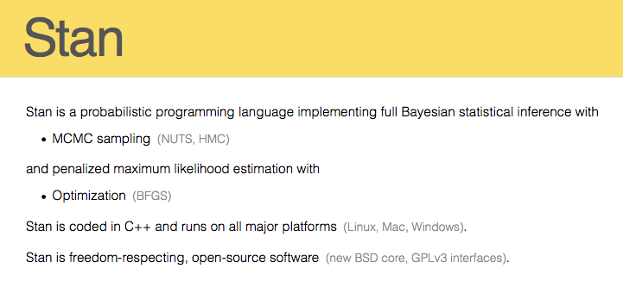
Ordered categorical mixed model with marker-specific known covariance
Acknowledgement: Andrew Gelman’s group in Columbia Univ.

Slide 19
Effects of covariates
Positive and negative values represent detrimental and protective effects
Sex1, Female, shows minor detrimental effect than Male
Age shows little effect
Effects of APOE genotypes concord with the literature
Results are consistent as compared with different models (Linear model, linear mixed model, ordered categorical model, ordered categorical mixed model) and estimation methods (Expectation Maximum, MCMC sampling)
Why APOE23 has less protective effect than APOE24?

Slide 20
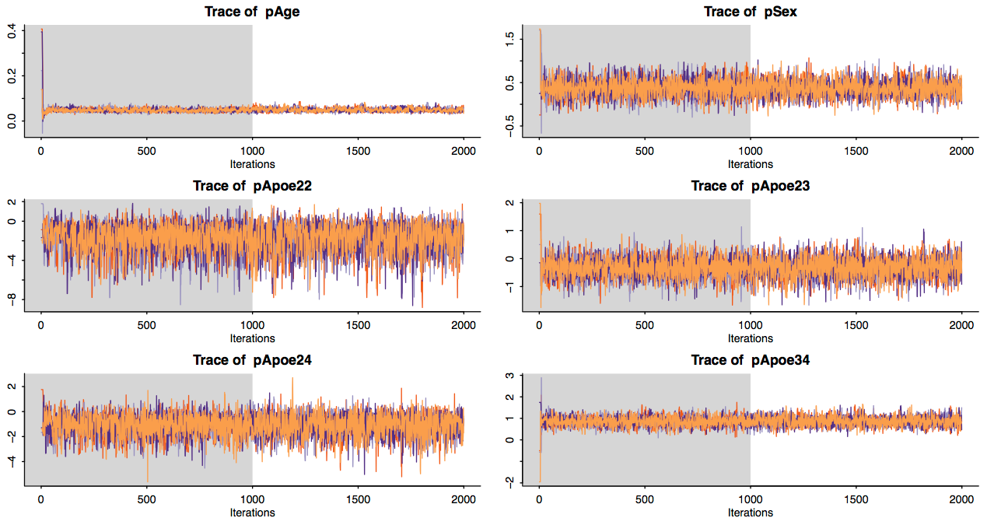
MCMC sampling of parameters’ posterior distributions
Bayesian inference with MCMC sampling implemented with Stan

Slide 21
Kinship coefficients
Kinship coefficients calculated with PLINK, KING, EMMA, DOQTL
Kinship coefficients of sample pairs within and between families as reported
Kinship coefficients computed with KING, EMMA, and DOQTL

Slide 22
Kinship coefficients
Kinship coefficients of sample pairs with genotype from autosome and leave-one-out autosome

Slide 23
Stan estimations on GLMM in the APOE locus
Optimization w/o APOE genotype
Optimization with APOE genotype
Sampling w/o APOE genotype
WAIC: Watanable-Akaike information criterion

Slide 24
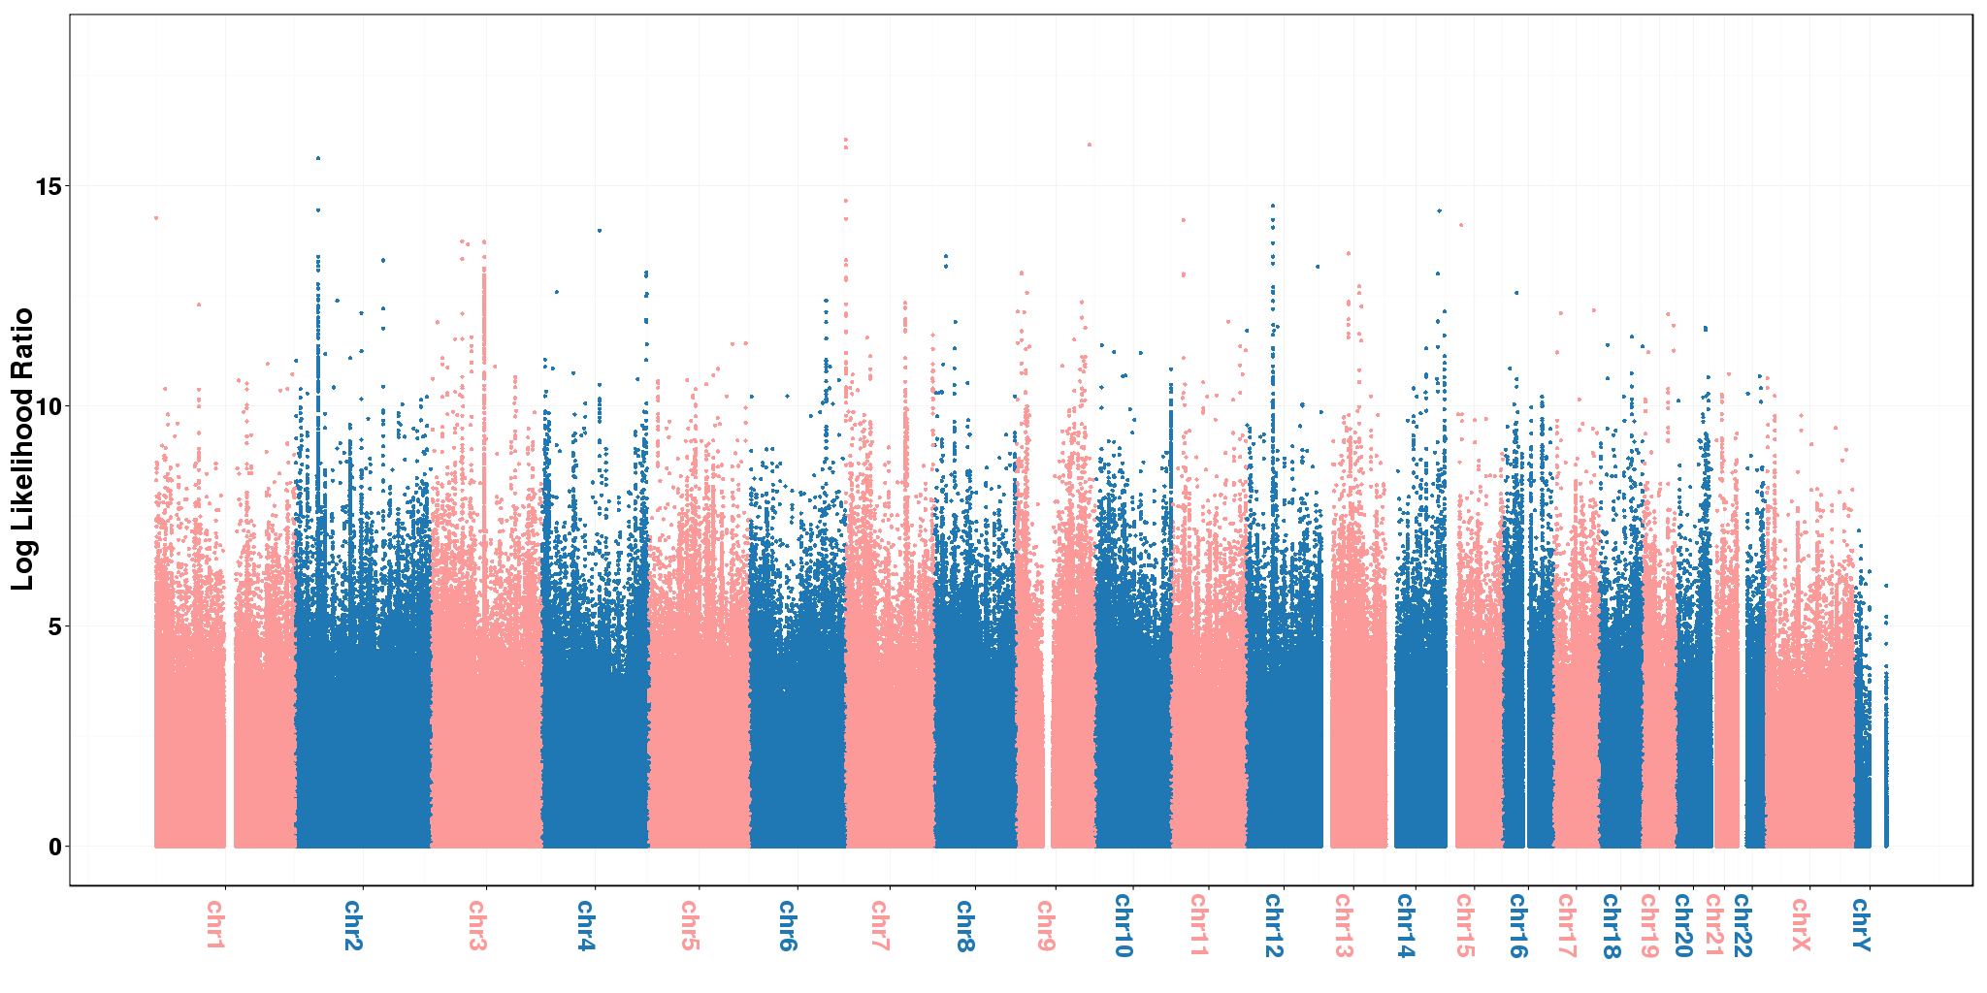
GWAS with GLMM

Slide 25
Significance with permutations
Permutation procedure
Randomly pick 1M SNP
Run models on permuted SNP
Save maximal LRT value
Repeat 1-3 3200 times
Set threshold as top 0.95 maximal LRT

Slide 26
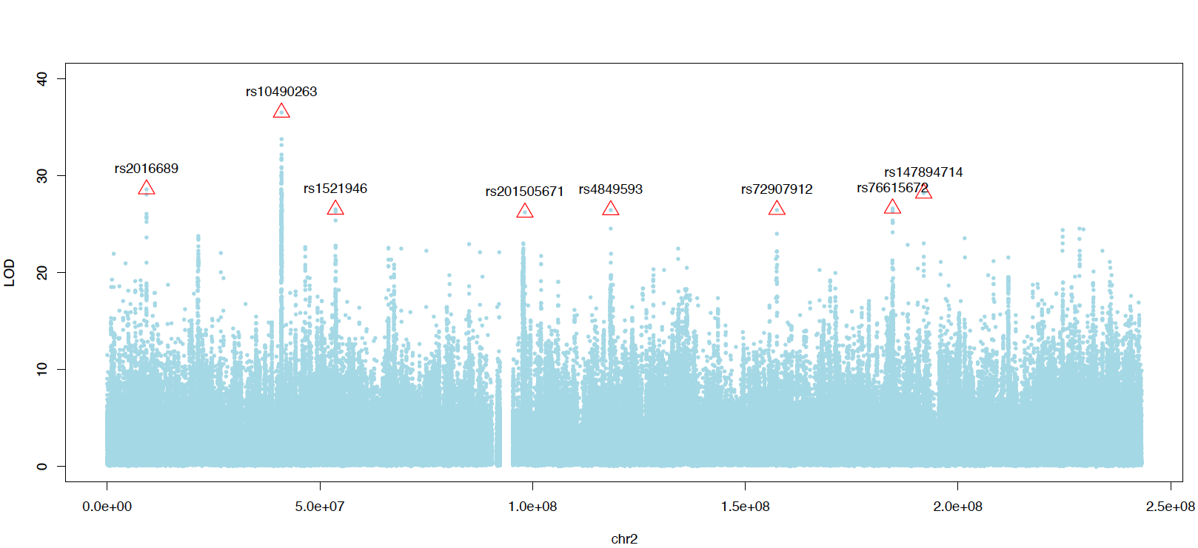
GWAS with GLMM
LOD trace in Chromosome 2 with GLMM and automatic peak detection

Slide 27
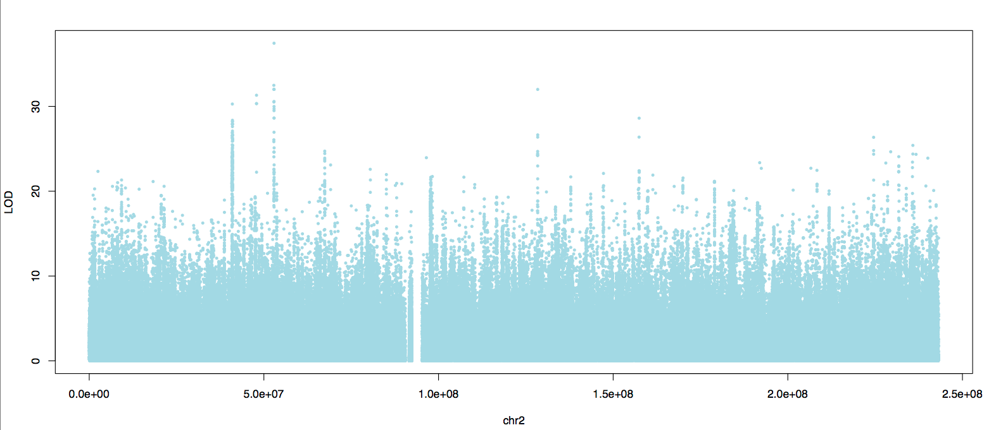
GWAS with Linear mixed model (LMM)
LOD trace in Chromosome 2 with QTLRel
Linear model by coding (No, Possible, Probable, Definite) as (0, 0.25, 0.5, 1).

Slide 28
RIN3 from the 21 loci: 5M bp range
Notes:
Some show significance.

Slide 29
Many new loci
Notes:
This is the first entry in the table

Slide 30
END
/sdata/ADSP/XuLong
/data/xwang/ADSP

Slide 31
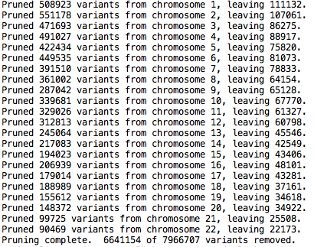
SNP pruning with LD
SNP pruning with PLINK
Notes:
Bayes’s rule states that the posterior probability of parameter θ given data y is proportional to the product of the likelihood function p(y|θ) and prior p(θ).

Slide 32
Candidate loci by CLM
Notes:
Chosen loci with model 3 as expressed on the top, and criteria on the bottom

Slide 33
Random effect distribution
MCMC sampling with random effect takes long: 30 min per marker
Plug in the mode for the random effect in full model
Notes:
Bayes’s rule states that the posterior probability of parameter θ given data y is proportional to the product of the likelihood function p(y|θ) and prior p(θ).

Slide 34
Pipeline in a brief
Genotype
Phenotype
Extracting SNP calls from CS’ VCF
Code: /data/xwang/ADSP/SH/myVcf.sh
Phenotype & metadata processing
Code~/Dropbox/ADSP/R/mdata.R
AD status: 584 -> 578
Other dementia and unknown
Age: 578 -> 576 (Missing data)
Run Null models for predictor selection
Code~/Dropbox/ADSP/R/analysis1.R
Generate complete genotype data Code: /data/xwang/ADSP/R/vdata.R
MODELS: Linear, Hierarchical linear, Cumulative link
Code: /data/xwang/ADSP/R/analysis[123].R
~/Dropbox/ADSP/R/analysis[234].R

Slide 35
Population structure
Family-based relatedness
Genotype-based relatedness
Identical by state algorithm for kinship matrix

Slide 36
Samples: Sex over AD status
Female proportion increases with AD probability
L: Sample sex proportion.
R: Sex over AD status.

Slide 37
Samples: Age over AD status
Age generally increases with AD probability
L: Pooled ages. R: Age over AD status.
Notes:
The boxplot on the right shows the age distributions for people in each of the four AD categories. They are generally comparable, with a slight increase in the probable and definite categories.
Outliers: Q1 - 1.5 * IQR, Q3 + 1.5 * IQR

Slide 38
Samples: AD status in Families
AD status across families are not balanced
AD diagnosis for 584 people across 111 families.

Slide 39
Effects of covariates
Sex1, Female, shows minor detrimental effect than Male
Age shows little effect
Effects of APOE genotypes concord with the literature

